Slide 1
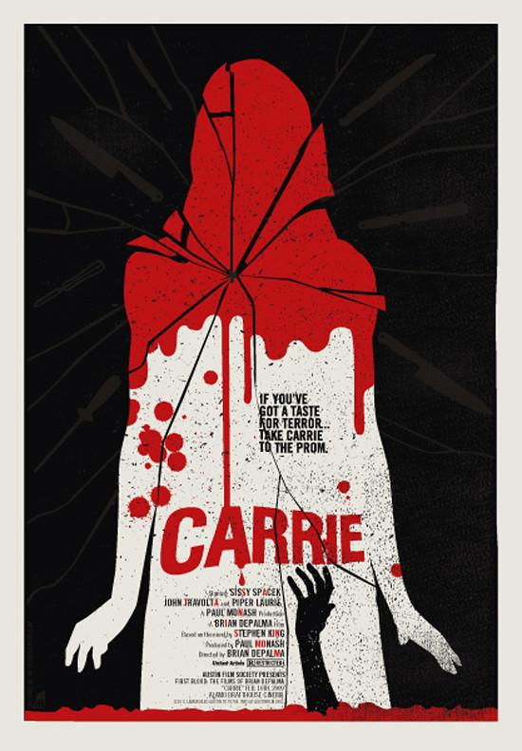
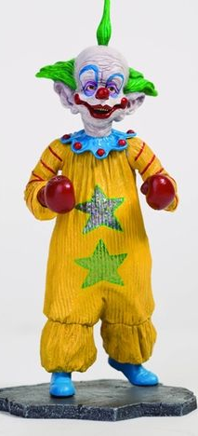
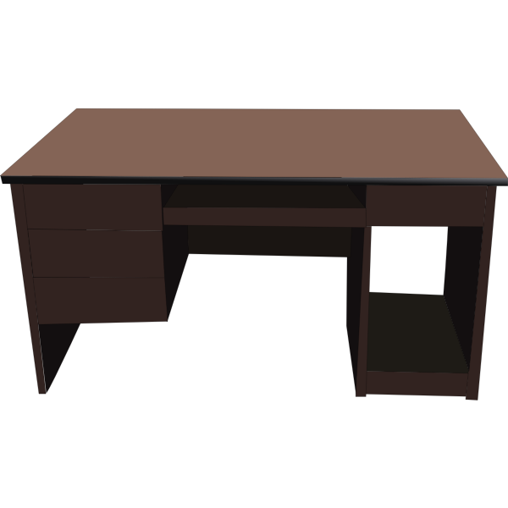
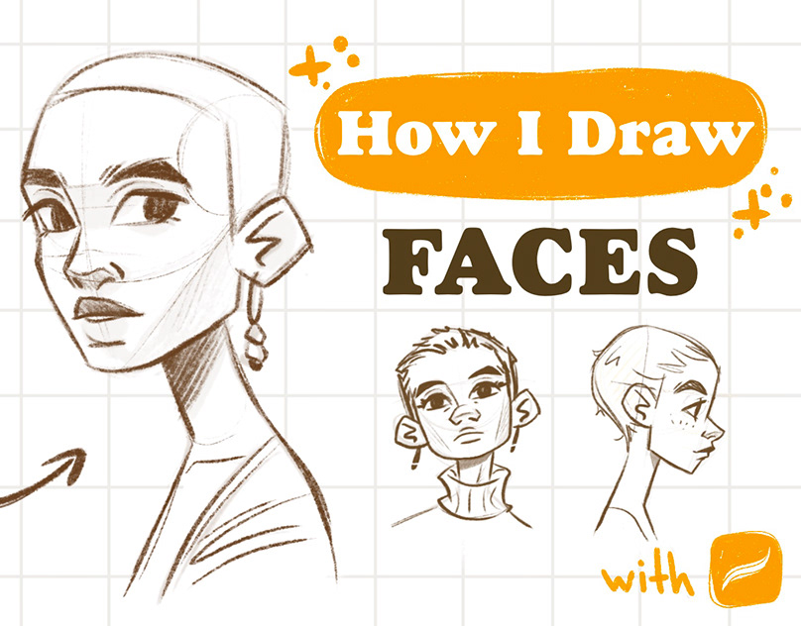
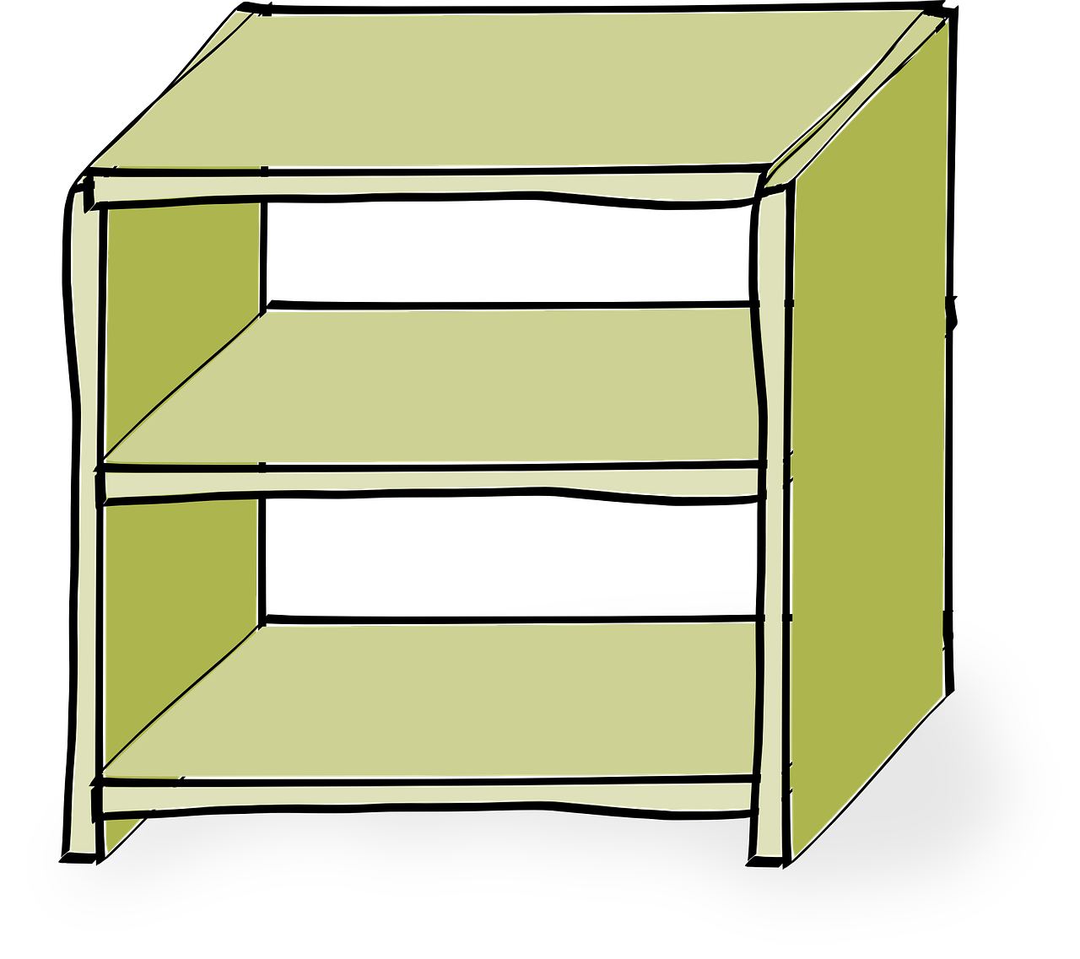
Welcome to KaSaundra’s virtual classroom!!
Disney Study Lofi
Links to my favorite sites:
Gothic Horror
Art Supply Warehouse
Kleki
Inspiration Grid
Draw Faces
Weebly Website
Figure drawing reference
Character Design
Find your art style

